Slide 1
Spam Classifier
A NLP project to predict weather a mail is spam or not?

Slide 2
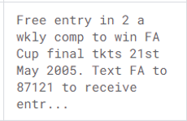

What problem is this project trying to solve?
Spam
Not Spam

Slide 3
Where did I get the data from?
This corpus has been collected from free or free for research sources at the Internet:
  UK forum
  NUS SMS Corpus (Research dept. of singapore)
  Caroline Tag's PhD Thesis
  source available for academic researches

Slide 4
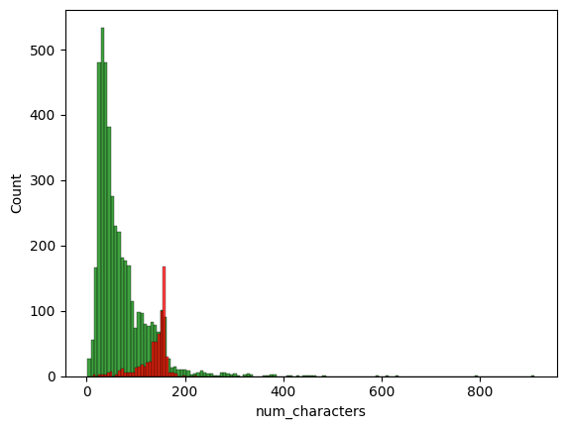

Slide 5
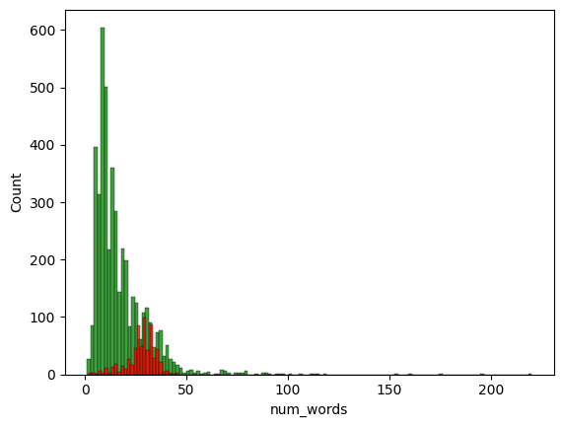

Slide 6
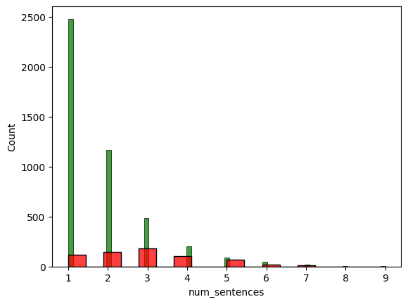

Slide 7
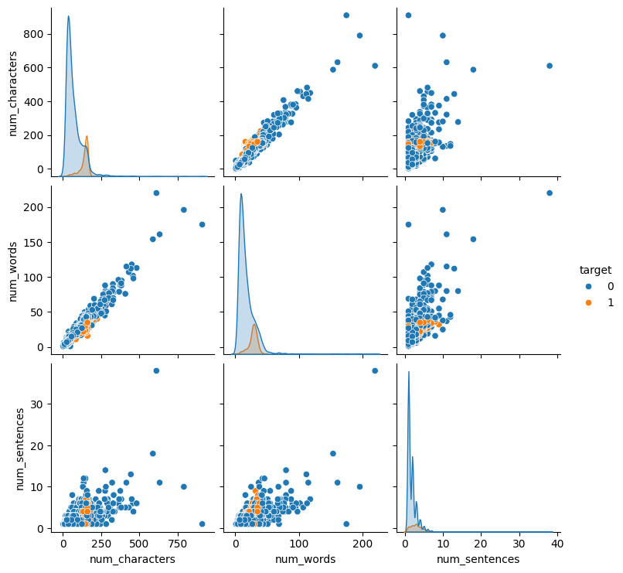
Relationship between input features

Slide 8
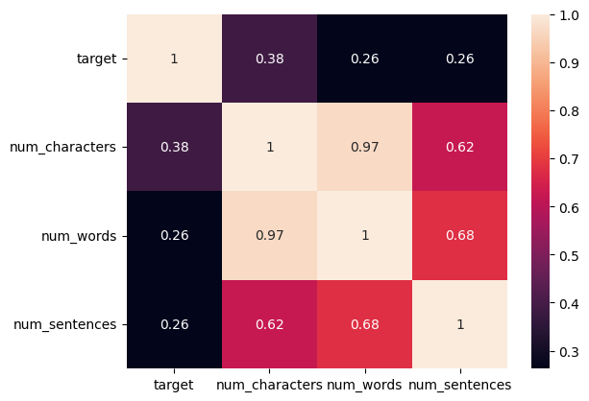
Correlation between input features

Slide 9
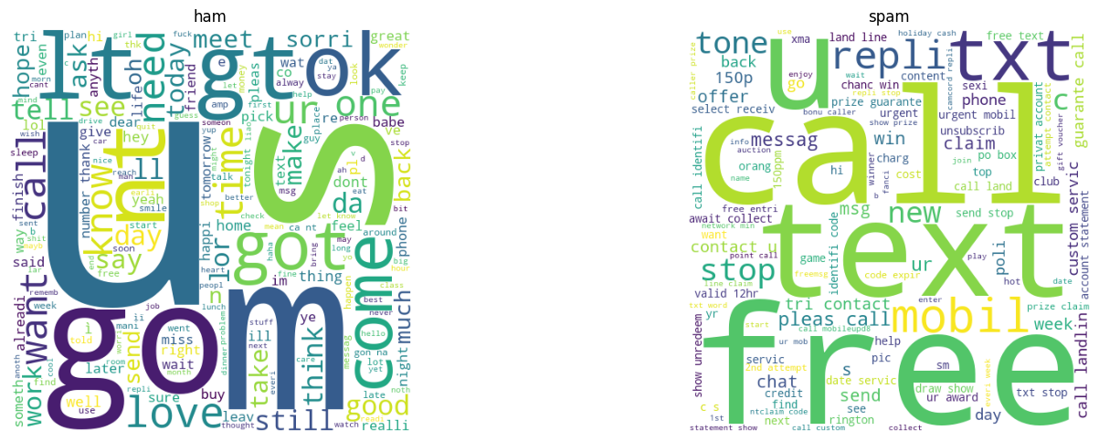
What words do messages contain?

Slide 10
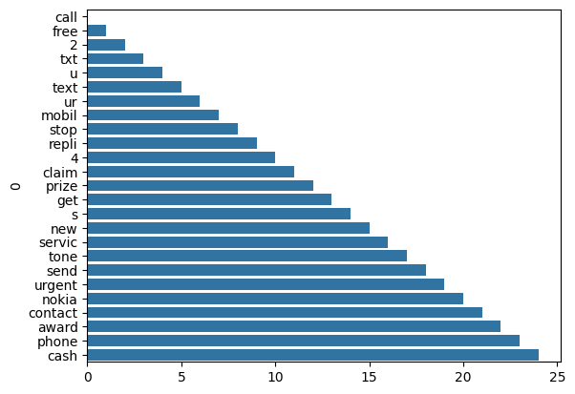
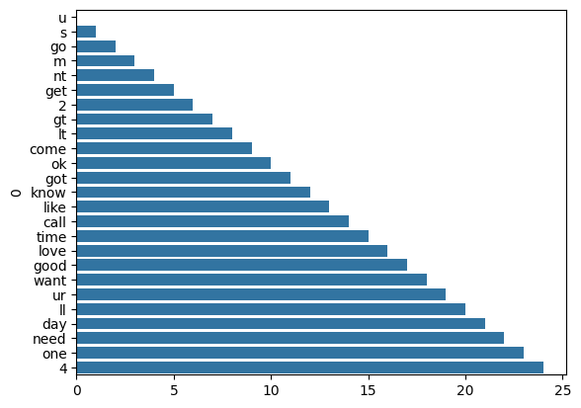
25 most common keyword in messages
Spam
Ham

Slide 11
Feature used for prediction?
the main input feture will be only the received text message
and other features are constructed from this single text message itself which are:
  no of characters in the message.
  no of words in the message.
  no of sentences in the message.
  presence of 25 most commonly used words.

Slide 12

How accurate is the final model?
Multinomial Naive Bayes
accuracy: 96%
precision: 73%
zero mistakes with False Positive Classification

Slide 13
Checking out the code behind the scene
Now let’s checkout the process followed to train, test and deploy this model.

Slide 14
Technical-Steps involved in DataAnalysis
Data Gathering
Data Cleaning
Feature Engineering
Model Training, Evaluation and Selection
Hyperparameter Tunning of best model
MLops

